Slide 1




Technical environmental systems
Simulation of Building Energy Performance via Open studio
2017-2018
Prof. Renzo Marchesi
Prof. Behzad Najafi
By : Merna Rakha
Mirna Abdelsaid
Mona Ibrahim
Monica Fahiem

Slide 2
Index
1.The building
Geometry
Its applications
Thermal zones
2. Option 1 : Piacenza city, Italy / Materials used (Type 1) / Output of the simulation
3. Option 2 : Cairo city, Egypt / Materials used (Type 1) / Output of the simulation
4. Option 3 : Rio de Janeiro city, Brazil / Materials used (Type1) / Output of the simulation
5. Option 4 : Piacenza city, Italy / Materials used (Type 2) / Output of the simulation
6. Comparison between all the options
Slides: 3-6
Slides: 7-9
Slides: 10-12
Slides: 13-15
Slides: 16-18
Slides: 19-20
Prof. Renzo Marchesi
Prof. Behzad Najafi
By : Merna Rakha
Mirna Abdelsaid
Mona Ibrahim
Monica Fahiem

Slide 3

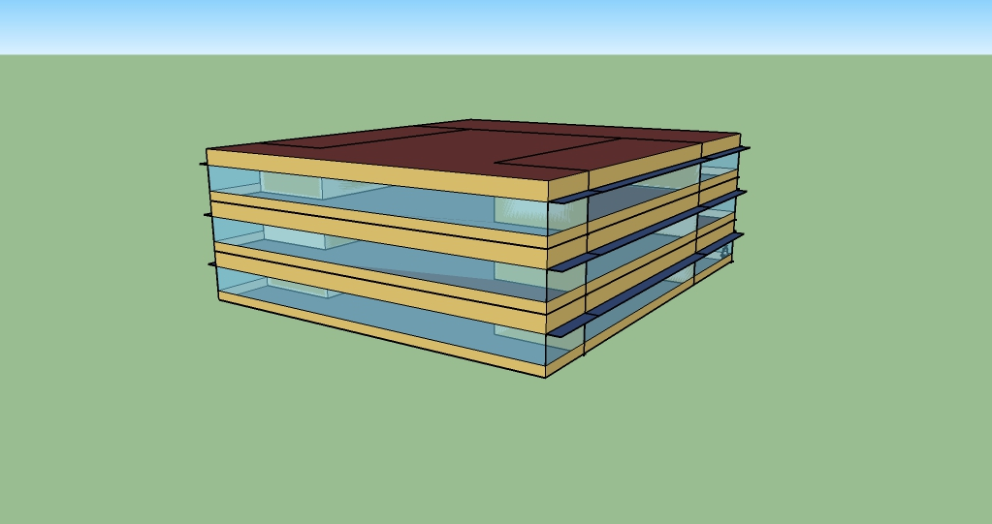

The building
It is an office building , it consists of 3 floors, each floor is 4 meters high.
Each floor consists of an open office, two closed offices and a break room.
Shaders were used on the exterior windows, except in the north direction.
Zone 2
Closed office
Zone 3
Open office
Zone 4
Closed office
Zone 1
Break room
3D
Plan
Prof. Renzo Marchesi
Prof. Behzad Najafi
By : Merna Rakha
Mirna Abdelsaid
Mona Ibrahim
Monica Fahiem

Slide 4
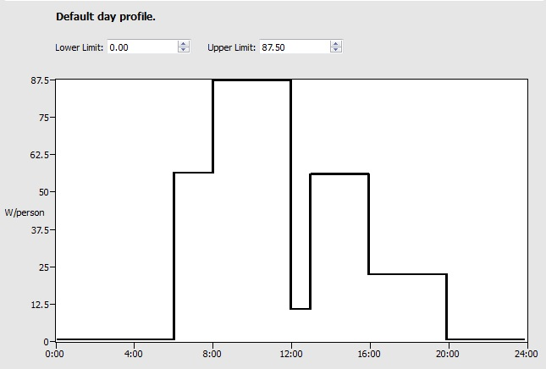
Thermal zones
•The open office:
The office usage starts from 6 a.m. until 8 p.m.
The highest value of usage is between 8 a.m. and 12 p.m.
While the lowest is between 12 p.m. and 1 p.m.
Hours
Prof. Renzo Marchesi
Prof. Behzad Najafi
By : Merna Rakha
Mirna Abdelsaid
Mona Ibrahim
Monica Fahiem

Slide 5
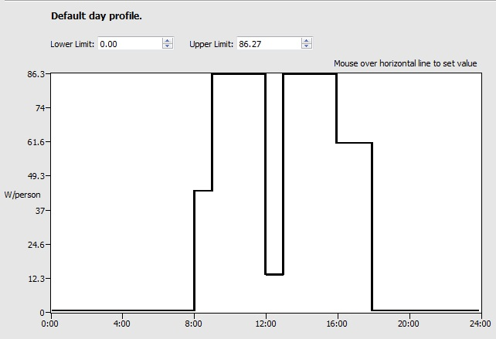
Thermal zones
•The closed office:
The office usage starts from 8 a.m. until 6 p.m.
The highest value of usage is between 9 a.m. and 12 p.m. and between
1 p.m. and 3 p.m..
While the lowest is between 12 p.m. and 1 p.m.
Hours
Prof. Renzo Marchesi
Prof. Behzad Najafi
By : Merna Rakha
Mirna Abdelsaid
Mona Ibrahim
Monica Fahiem

Slide 6
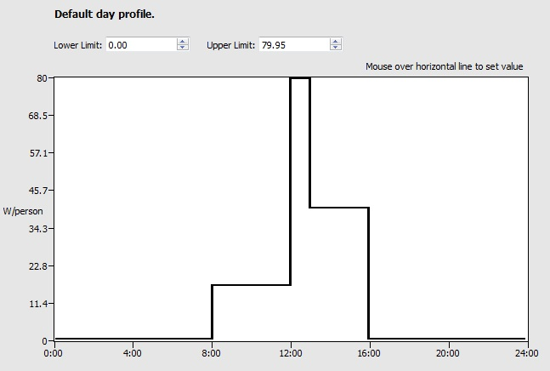
Thermal zones
•The break room:
The room usage starts from 8 a.m. until 4 p.m.
The highest value of usage is between 12 p.m. and 1 p.m., which is the time of the lunch break.
While the lowest is between 8 a.m. and 12 p.m.
Hours
Prof. Renzo Marchesi
Prof. Behzad Najafi
By : Merna Rakha
Mirna Abdelsaid
Mona Ibrahim
Monica Fahiem

Slide 7
Option 1
1st type of walls / Piacenza city, Italy
•Design days:
Peak time for district heating: 4th of December, for district cooling: 11th of July.
•The materials:
-For the exterior walls, materials used are:
(1 IN Stucco) 0.0253m thick / (8 IN concrete) 0.2033m thick / wall insulation(44) 0.1104m thick / (½ IN gypsum) 0.0127m thick
-For the interior walls, materials used are:
(G05 25mm Wood) 0.0254m thick / (F04 wall air space resistance) 0.15 m2.K/W of thermal resistance / (G01a 19mm gypsum board) 0.019m thick
-For the flooring: (interior floor):
(F16 acoustic tiles) 0.0191m thick / (F05 air space resistance) 0.18 m2.K/W of thermal resistance / (M11 100mm light weight concrete) 0.1016m thick
Prof. Renzo Marchesi
Prof. Behzad Najafi
By : Merna Rakha
Mirna Abdelsaid
Mona Ibrahim
Monica Fahiem

Slide 8
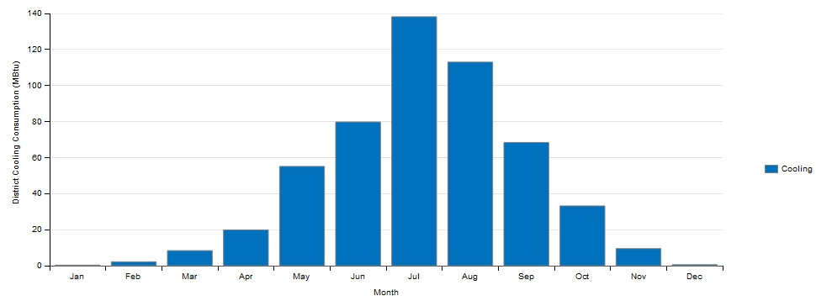
District cooling : Monthly overview
 | Jan | Feb | Mar | Apr | May | Jun | Jul | Aug | Sep | Oct | Nov | Dec | Total
Cooling MBTU | 0.33 | 2.19 | 8.37 | 19.88 | 55.11 | 79.77 | 138.17 | 113.01 | 68.41 | 33.17 | 9.49 | 0.56 | 528.45
kW.h | 96.71 | 641.83 | 2453.004 | 5826.25 | 16151.15 | 23378.28 | 40493.63 | 33120 | 20049 | 9721.17 | 2781.24 | 164.12 | 154873.41
We can see from the results that the highest consumption value is in July with 40493.63 kW.h, while the lowest is in January with 96.71 kW.h
Prof. Renzo Marchesi
Prof. Behzad Najafi
By : Merna Rakha
Mirna Abdelsaid
Mona Ibrahim
Monica Fahiem

Slide 9
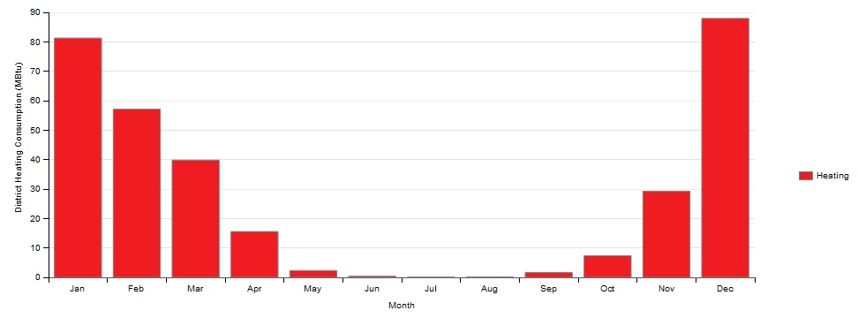
District heating : Monthly overview
 | Jan | Feb | Mar | Apr | May | Jun | Jul | Aug | Sep | Oct | Nov | Dec | Total
Heating MBTU | 81.27 | 57.12 | 39.82 | 15.57 | 2.32 | 0.39 | 0.09 | 0.15 | 1.63 | 7.32 | 29.28 | 87.94 | 322.9
kW.h | 23817.89 | 16766.6 | 11670.1 | 4563.12 | 679.92 | 114.3 | 26.38 | 43.9 | 477.71 | 2145.28 | 8581.12 | 25772.67 | 94632.65
We can see from the results that the highest consumption value is in December with 25772.67 kW.h, while the lowest is in July with 26.38 kW.h.
For this option, we conclude that the cooling process consume more energy than the heating process.
Prof. Renzo Marchesi
Prof. Behzad Najafi
By : Merna Rakha
Mirna Abdelsaid
Mona Ibrahim
Monica Fahiem

Slide 10
Option 2
1st type of walls / Cairo city, Egypt
•Design days:
Peak time for district heating: 2nd of January, for district cooling: 23th of August.
•The materials:
-For the exterior walls, materials used are:
(1 IN Stucco) 0.0253m thick / (8 IN concrete) 0.2033m thick / wall insulation(44) 0.1104m thick / (½ IN gypsum) 0.0127m thick
-For the interior walls, materials used are:
(G05 25mm Wood) 0.0254m thick / (F04 wall air space resistance) 0.15 m2.K/W of thermal resistance / (G01a 19mm gypsum board) 0.019m thick
-For the flooring: (interior floor):
(F16 acoustic tiles) 0.0191m thick / (F05 air space resistance) 0.18 m2.K/W of thermal resistance / (M11 100mm light weight concrete) 0.1016m thick
Prof. Renzo Marchesi
Prof. Behzad Najafi
By : Merna Rakha
Mirna Abdelsaid
Mona Ibrahim
Monica Fahiem

Slide 11
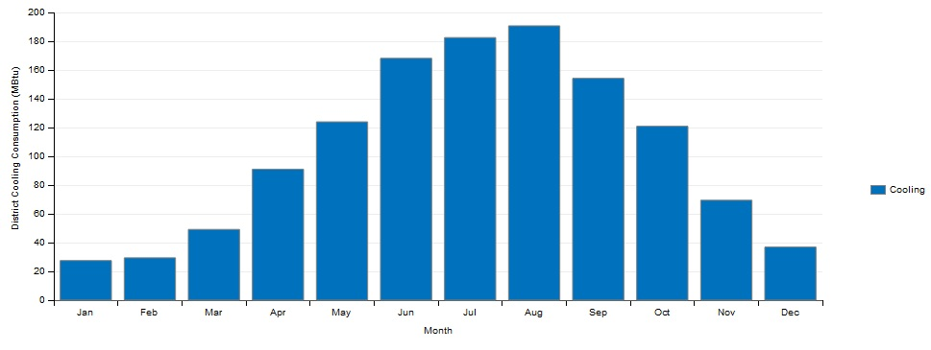
District cooling : Monthly overview
 | Jan | Feb | Mar | Apr | May | Jun | Jul | Aug | Sep | Oct | Nov | Dec | Total
Cooling MBTU | 27.52 | 29.42 | 49.18 | 91.05 | 123.96 | 168.14 | 182.55 | 190.7 | 154.22 | 120.9 | 69.46 | 36.91 | 1244.01
kW.h | 8065.32 | 8622.51 | 14413.24 | 26684.12 | 36329.09 | 49276.97 | 53500.12 | 55888.65 | 45197.42 | 35432.29 | 20356.72 | 10817.25 | 364583.34
We can see from the results that the highest consumption value is in August with 55888.65 kW.h, while the lowest is in January with 8065.32 kW.h.
Prof. Renzo Marchesi
Prof. Behzad Najafi
By : Merna Rakha
Mirna Abdelsaid
Mona Ibrahim
Monica Fahiem

Slide 12
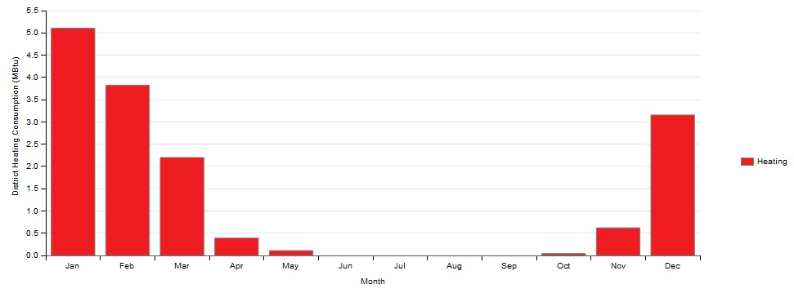
District heating : Monthly overview
 | Jan | Feb | Mar | Apr | May | Jun | Jul | Aug | Sep | Oct | Nov | Dec | Total
Heating MBTU | 5.1 | 3.83 | 2.2 | 0.39 | 0.11 | 0 | 0 | 0 | 0 | 0.04 | 0.62 | 3.16 | 15.45
kW.h | 1494.66 | 1122.46 | 644.76 | 114.3 | 32.24 | 0 | 0 | 0 | 0 | 11.72 | 181.7 | 926.1 | 4527.95
We can see from the results that the highest consumption value is in January with 1494.66 kW.h, while the lowest is in June, July, August& September with 0 kW.h.
For this option, we conclude that the cooling process consume more energy than the heating process.
Prof. Renzo Marchesi
Prof. Behzad Najafi
By : Merna Rakha
Mirna Abdelsaid
Mona Ibrahim
Monica Fahiem

Slide 13
Option 3
1st type of walls / Rio de Janeiro city, Brazil
•Design days:
Peak time for district heating: 15th of July, for district cooling: March.
•The materials:
-For the exterior walls, materials used are:
(1 IN Stucco) 0.0253m thick / (8 IN concrete) 0.2033m thick / wall insulation(44) 0.1104m thick / (½ IN gypsum) 0.0127m thick
-For the interior walls, materials used are:
(G05 25mm Wood) 0.0254m thick / (F04 wall air space resistance) 0.15 m2.K/W of thermal resistance / (G01a 19mm gypsum board) 0.019m thick
-For the flooring: (interior floor):
(F16 acoustic tiles) 0.0191m thick / (F05 air space resistance) 0.18 m2.K/W of thermal resistance / (M11 100mm light weight concrete) 0.1016m thick
Prof. Renzo Marchesi
Prof. Behzad Najafi
By : Merna Rakha
Mirna Abdelsaid
Mona Ibrahim
Monica Fahiem

Slide 14
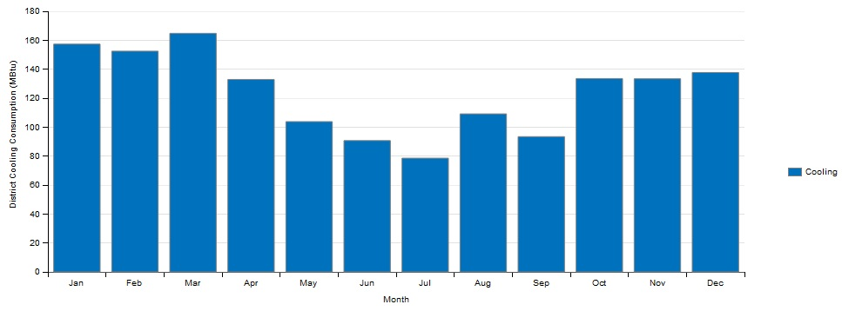
District cooling : Monthly overview
 | Jan | Feb | Mar | Apr | May | Jun | Jul | Aug | Sep | Oct | Nov | Dec | Total
Cooling MBTU | 157.33 | 152.45 | 164.78 | 132.93 | 103.79 | 90.7 | 78.56 | 109.15 | 93.43 | 133.56 | 133.4 | 137.73 | 1487.81
kW.h | 46108.87 | 44678.68 | 48292.25 | 38957.94 | 30417.85 | 26581.55 | 23023.66 | 31988.71 | 27381.63 | 39142.57 | 39095.68 | 40364.68 | 436034.07
We can see from the results that the highest consumption value is in March with 48292.25 kW.h, while the lowest is in July with 23023.66 kW.h.
Prof. Renzo Marchesi
Prof. Behzad Najafi
By : Merna Rakha
Mirna Abdelsaid
Mona Ibrahim
Monica Fahiem

Slide 15
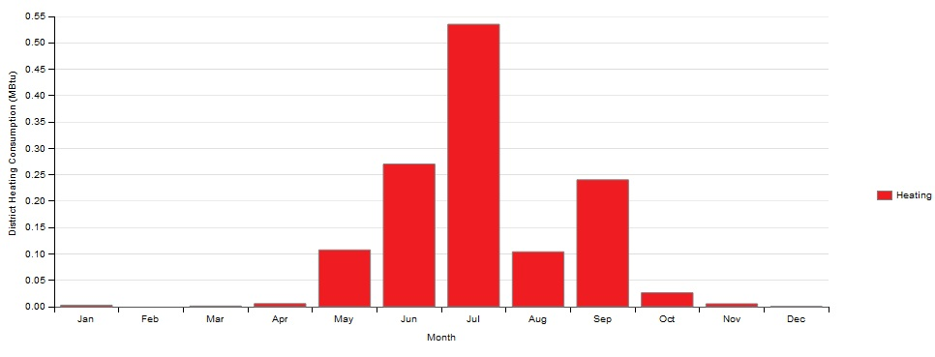
District heating : Monthly overview
 | Jan | Feb | Mar | Apr | May | Jun | Jul | Aug | Sep | Oct | Nov | Dec | Total
Heating MBTU | 0 | 0 | 0 | 0.01 | 0.11 | 0.27 | 0.54 | 0.1 | 0.24 | 0.03 | 0.01 | 0 | 1.3
kW.h | 0 | 0 | 0 | 2.93 | 32.24 | 79.13 | 158.26 | 29.31 | 70.34 | 8.8 | 2.93 | 0 | 380.99
We can see from the results that the consumption of energy for heating in Rio de Janeiro city is very low. The highest consumption value is in July with 158.26 kW.h, while the lowest is in January, February, March& December with 0 kW.h. For this option, we conclude that the cooling process consume more energy than the heating process.
Prof. Renzo Marchesi
Prof. Behzad Najafi
By : Merna Rakha
Mirna Abdelsaid
Mona Ibrahim
Monica Fahiem

Slide 16
Option 4
2nd type of walls / Piacenza, Italy
•Design days:
Peak time for district heating: 4th of December, for district cooling: 11th of July.
•The materials:
-For the exterior walls, materials used are:
(F08 Metal Surface) 0.0008m thick / (I01 25mm insulation board) 0.0254m thick / F04 Wall air space resistance of 0.15 m2.k/w thermal resistance / (G01a 19mm gypsum board) 0.0127m thick
-For the interior walls, materials used are:
(G01a 19mm gypsum board) 0.002m thick/ (F04 wall air space resistance) 0.15 m2.K/W of thermal resistance / (G01a 19mm gypsum board) 0.002m thick
-For the flooring: (interior floor):
(F16 acoustic tiles) 0.0191m thick / (F05 air space resistance) 0.18 m2.K/W of thermal resistance / (M11 100mm light weight concrete) 0.1016m thick
Prof. Renzo Marchesi
Prof. Behzad Najafi
By : Merna Rakha
Mirna Abdelsaid
Mona Ibrahim
Monica Fahiem

Slide 17
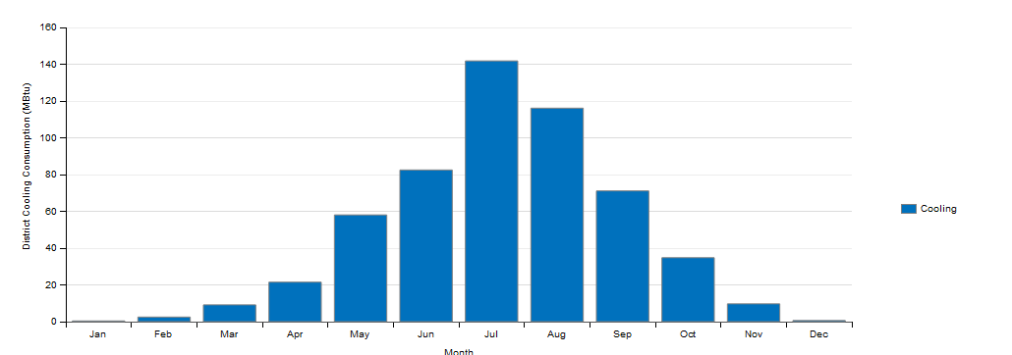
District cooling : Monthly overview
 | Jan | Feb | Mar | Apr | May | Jun | Jul | Aug | Sep | Oct | Nov | Dec | Total
Cooling MBTU | 0.39 | 2.5 | 9.13 | 21.49 | 58.05 | 82.5 | 141.8 | 116.1 | 71.12 | 34.78 | 9.69 | 0.62 | 548.16
kW.h | 114.3 | 732.68 | 2675.74 | 6298.1 | 17012.78 | 24178.36 | 41557.48 | 34025.55 | 20843.21 | 10193.01 | 2839.86 | 181.7 | 160649.84
We can see from the results that the highest consumption value is in July with 41557.48 kW.h, while the lowest is in January with 114.3 kW.h.
Prof. Renzo Marchesi
Prof. Behzad Najafi
By : Merna Rakha
Mirna Abdelsaid
Mona Ibrahim
Monica Fahiem

Slide 18
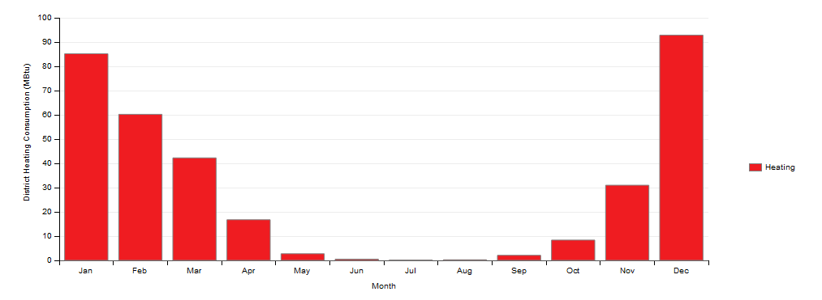
District heating : Monthly overview
 | Jan | Feb | Mar | Apr | May | Jun | Jul | Aug | Sep | Oct | Nov | Dec | Total
Heating MBTU | 85.18 | 60.2 | 42.26 | 16.75 | 2.73 | 0.51 | 0.12 | 0.25 | 2.09 | 8.36 | 30.98 | 92.85 | 342.29
kW.h | 24963.79 | 17642.88 | 12385.18 | 4908.94 | 800.08 | 149.47 | 35.17 | 73.27 | 612.52 | 2450.07 | 9079.34 | 27211.65 | 100315.3
We can see from the results that the highest consumption value is in December with 27211.65 kW.h, while the lowest is in July with 35.17 kW.h.
For this option, we conclude that the cooling process consume more energy than the heating process.
Prof. Renzo Marchesi
Prof. Behzad Najafi
By : Merna Rakha
Mirna Abdelsaid
Mona Ibrahim
Monica Fahiem

Slide 19
Outputs
 | Total yearly consumption for cooling | Total yearly consumption for heating
Option 1 Piacenza | 557.54 GJ | 340.67 GJ
 | 154873.41 kW.h | 94632.65 kW.h
Option 2 Cairo | 1312.50 GJ | 16.30 GJ
 | 364583.34 kW.h | 4527.95 kW.h
Option 3 Rio de Janeiro | 1569.72 GJ | 1.37 GJ
 | 436034.07 KW.h | 380.99 KW.h
Option 4 Piacenza | 578.34 GJ | 361.14 GJ
 | 160649.84 KW.H | 100315.3 KW.h
Option 3 has the highest value of energy consumption for cooling process, therefore the most expensive in terms of cooling costs.
Option 4 has the highest value of energy consumption for heating process, therefore the most expensive in terms of heating costs.
Prof. Renzo Marchesi
Prof. Behzad Najafi
By : Merna Rakha
Mirna Abdelsaid
Mona Ibrahim
Monica Fahiem

Slide 20
Conclusion
From the results of the first type of materials used, we conclude that for the three cities the consumption of energy for the cooling is higher than the heating. Therefore, building’s energy costs are higher in the cooling process.
And for both cities of Cairo and Rio de Janeiro, in terms of the interior cooling, the type of materials used caused the consumption of greater levels of energy required for the cooling of the building.
When we compare between option 1 and option 4, where we used two different types of materials in Piacenza city, we can see that the energy consumption for both heating and cooling was lower in option 1. Which means that the first type of materials used is the ideal one for this type of building in Piacenza’s weather and costs less in terms of energy consumption.
Prof. Renzo Marchesi
Prof. Behzad Najafi
By : Merna Rakha
Mirna Abdelsaid
Mona Ibrahim
Monica Fahiem

